Slide 1

MongoDB
A Hitchhikers guide to the Database

Slide 2

Green Energy
American Muscle

Slide 3
Mongo
Oracle

Slide 4

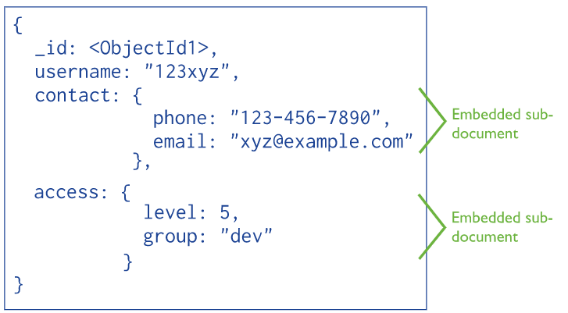
What is it
Open Source NoSQL Database
JSON Object Store
Easy to use
Powerful query language
Supports all expected database-y stuff
There is a commercial wing
Natively scalable – designed for humongous databases

Slide 5

Mongo

Slide 6
Mongo

Slide 7
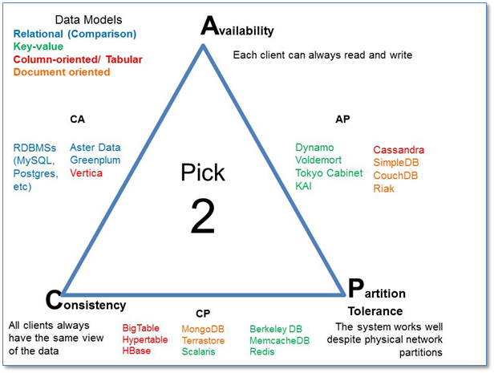
CAP Theorem

Slide 8
CAP Theorem

Slide 9

When should I use it
Almost always!!
Data model has a nested structure
Data objects are self contained
High read/write throughput
Large data volume
High Availability (Replication)
High Scalability (Sharding)
Dynamic data model

Slide 10
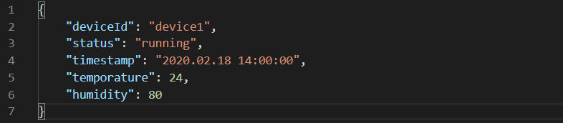

IOT Device output

Slide 11
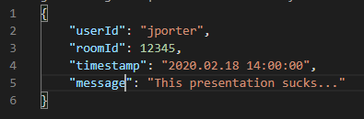
Chatroom

Slide 12
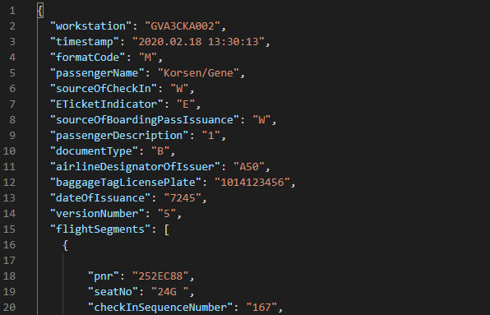
Boarding Pass Event

Slide 13
When should I use it
Almost always!!
Data model has a nested structure
Data objects are self contained
High read/write throughput
Large data volume
High Availability (Replication)
High Scalability (Sharding)
Dynamic data model

Slide 14
When should I NOT use it
On the ATI Cloud!
Recommend a managed cluster
Data model must be relational/normalised
ACID transactions
Limited support for transactions
Replication Lag
Where the data model has been designed upfront

Slide 15
How do I use it effectively
Keep frequently accessed data together
Embedding Documents
1 – 1 relationships
1 – Many relationships
3 Main Questions:
Reads v Inserts v Updates
Keep data together for high reads and inserts
Split data if high updates (pre 4.2)
How will the data be accessed
Split data if a subset is most frequently read
Common calculations can be done on insert/update
Document size
Documents should never be allowed to grow indefinitely
Large documents are slow to retrieve and require more ram
Small documents lead to larger indexes which require more ram
Consider putting data into buckets
Design for Simplicity, Performance, Scalability
Don’t be afraid duplicate data
Don’t overdesign

Slide 16
How do I use it effectively
Indexes
Order of index fields
Reuse of Indexes
When no matching index – nesting
Ensure indexes fit in RAM
Minimise data transfer
Push grouping, aggregates, sorting, filtering, projections and joining to the database
Aggregation Pipeline
Minimise updates
If write heavy then structure you data so that updates are handled as simple inserts
If you must use updates use the Update Aggregation Pipeline (4.2+)

Slide 17
Useful Links
Data modelling Guide:
https://docs.mongodb.com/manual/core/data-modeling-introduction/
Indexing:
https://docs.mongodb.com/manual/indexes/
Useful set of videos from Mongo:
https://www.mongodb.com/webinar/back-to-basics-webinar-series-2019?utm_campaign=Int_WB_Back%20to%20Basics%20Series%20%28English%29_01_19_EMEA%20-%20sharding&utm_medium=email&utm_source=Eloqua
Very basic sample projects in .net core and Java 8:
https://github.com/jlptheman/MongoDB-Example
Currently WIP – let me know if anyone wants me to finish this out

